Slide 2
Niagara Analytics
Kyle Sardinia
Sales Engineer
Kyle.Sardinia@tridium.com

Slide 3
Objectives
Why you would need Analytics?
Define Niagara Analytics
How Niagara Analytics Works
What tools do I get with Niagara Analytics?
Niagara Analytics 2.1
Notes:
Out of the Box
How does the niagara framework help me ?
Tools for Sis
25 points out of the box

Slide 4
Analytics at-a-glance
Analytics - a thorough study; the method of logical analysis
Buzzword - An important-sounding usually technical word or phrase often of little meaning used chiefly to impress laymen
Notes:
Source: Miriam-Webster online

Slide 5
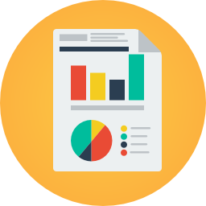
Why would you need Analytics
Machine Intelligence and Learning to filter and sort your data
Expense Allocation – Help reduce Operations Expense and Increase Efficiency on Capital Expense
Ongoing Automated Fault Detection and Diagnostics

Slide 6
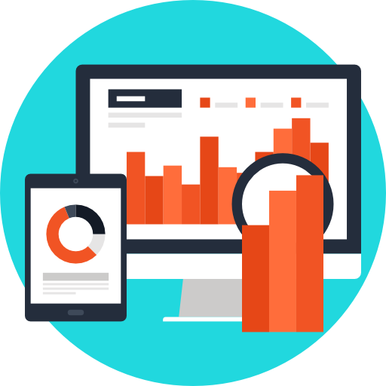
Why would you need Analytics
Keep Continuous Commissioning of your systems – track patterns and behavior
Resource Optimization – Reduce nuisance alarms and allocate key recourses efficiently
Help System Integrators to take advantage of their experience and system knowledge - package and apply it for customers
Notes:
Equipment data is operating correctly, validating right stuff, mapped correctly, performing properly
Analytics validating. Verifying efficiencies, heating and cooling simultaneous, vavs wide open, dirty airhandlers, identify those types of faults

Slide 7
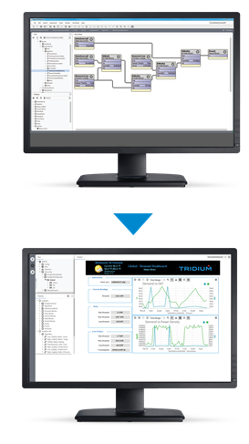
Niagara Analytics at-a-glance
Logical Data Analytics extension integrated with the Niagara 4 Framework ®
Tested & Supported on Niagara 4 Supervisors and JACE 8000 (Niagara 4 version 4.2)
Ease of learning & use defined by familiar Niagara wire sheet programming logic
Closed Loop Control measure & analyze trend and real time data and take action in a closed loop manner
Notes:
Features
The heart of the framework is an advanced high-performance calculation engine. With this engine real-time
data can be combined with historical data using a set of wire and property sheets. This visual programming
interface defines algorithms (formulas) that analyze the real-time and trend data collected from components,
devices, and points. The output from this analysis can be visualized in charts and used as input to standard
Niagara logic.
When applied to historical and real-time data, framework algorithms (formulas) can help you gain insight to
better manage your operations. The product includes these features:
• An open and extensible analytical environment that you can customize to meet your needs
• Analytic tools that apply to any industry, including manufacturing, as well as building management
• The ability to set up complex analysis without custom programming
• Support for third-party API visualization and other complementary applications

Slide 8
How the Niagara Analytics Framework Works

Slide 9
Configuring Niagara Analytics
Niagara Analytics is comprised of modules
analytics-lib-ux.jar
analytics-rt.jar is required by both stations and engineering platforms running tools (Workbench)
analytics-ux.jar
analytics-wb.jar is the user interface. This module is required to run the engineering tool
Notes:
Included in (most) OEM image or downloaded from Niagara central

Slide 10
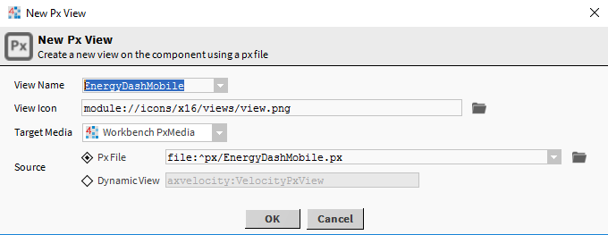
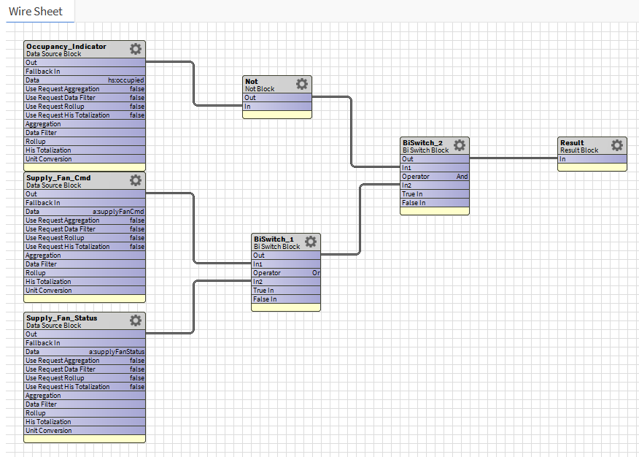
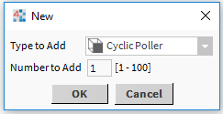
Performing Niagara Analytics
Four Events initiate an action
Poll triggers an automated alert
User opens a Px View, Ux Chart
User opens a Niagara Wire Sheet that contains a Niagara Analytics point
Third-party API initiates an operation

Slide 11
Tag Dictionary Service
Workbench
Notes:
EXPLAIN DICTIONARIES USED IN STATION
APPLIED DATA MODELING TO THE APPLICATION ALREADY
USING THE STANDARD TOOLS
HOPEFULLY EVERYONE IS ALREADY FAMILIAR WITH THE PROCESS AND ATTENDED YESTERDAYS SESSION

Slide 12
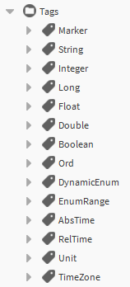
Tags
Defined in a dictionary and provide semantic meaning for that specific dictionary.
Marker tags have no value, rather they apply some semantics by the fact they are applied.
Value tags include additional semantic information such as a string, number, boolean or time value.

Slide 13
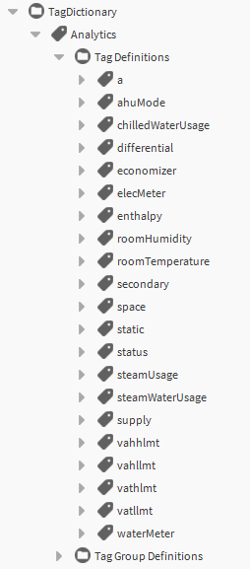
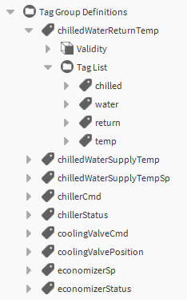
Analytic Tag Dictionary
Provides set of tags and tag groups designed for Niagara Analytics
Drag directly from “analytics-lib” palette“ to the Tag Dictionary Service
Tag Groups assign all tags contained in that group

Slide 14
Hierarchy Service
Workbench
Notes:
Service or Tree view
Explain trees have been built to organize things in the station already
Hierarchies are beneficial in analytics because components in the tree may not be organized logically in a way that allows for data aggregation

Slide 15
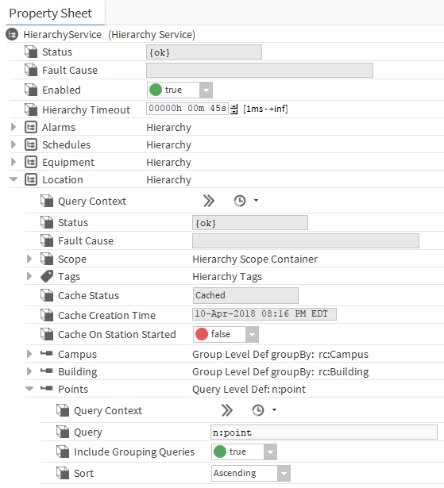
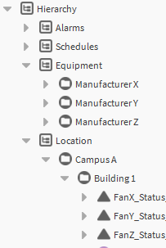
Hierarchies
Efficient method of creating logical navigation trees.
Leverages tags and relations using NEQL queries.
Dynamically updates.
Alternative to using nav files

Slide 16
Analytic Service Property Sheet
Workbench
Notes:
Shows number of alerts, algorithms, points(the sources to algorithms)
Points are how Niagara Analytics is licensed
Point count is determined by the number of points used in an analytic request,
One point can be used in multiple requests and only counted once against the license

Slide 17
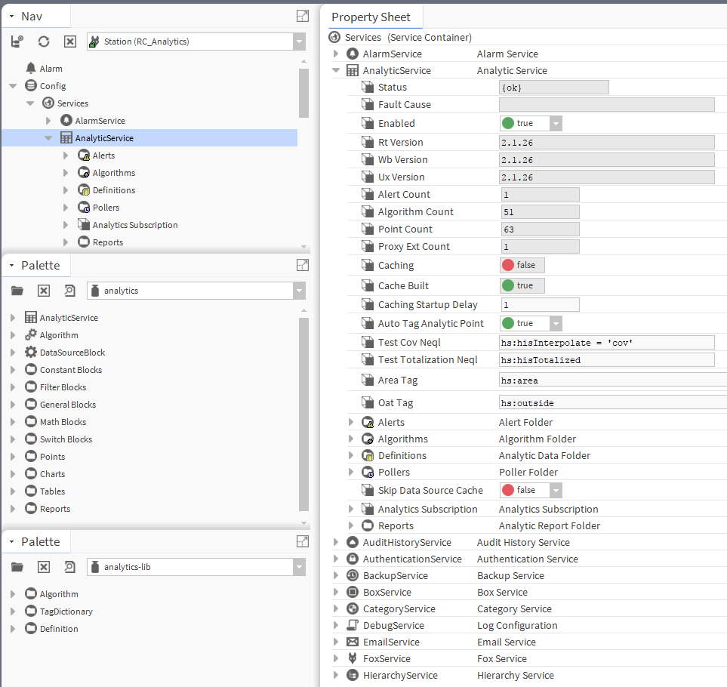
Configuring Niagara Analytics
Two Additional Palettes
Configured in Analytics Services
Palettes contain pre-configured algorithms, tag dictionaries, and definitions
Palettes contain tools to build analytics components and visualizations
Notes:
Two palettes
Drag in analytics service
Services composed of (alerts, algorithms, definitions, pollers, reports)
Auto tag (a:a)

Slide 18
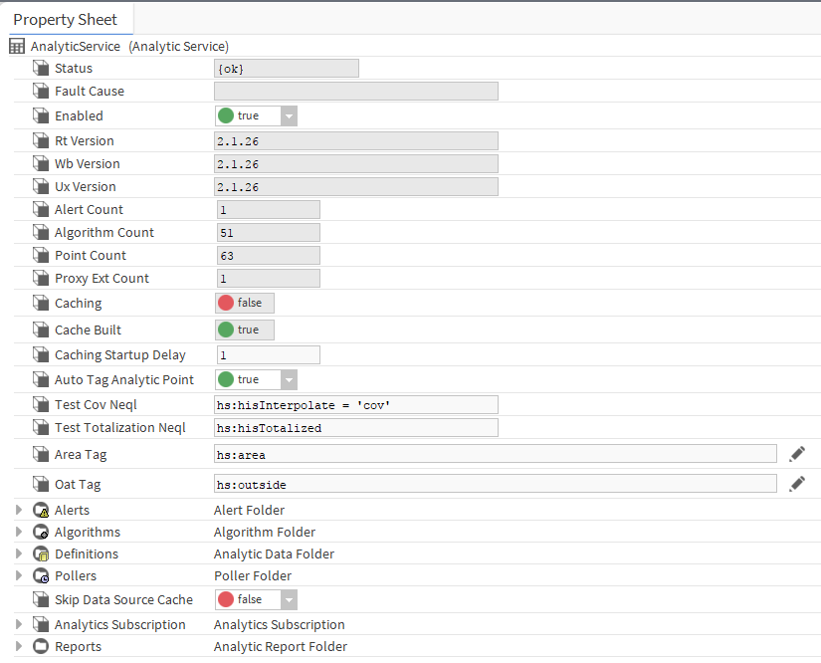
Components, Views, and Windows
Analytics Service contains:
Alerts
Algorithms
Definitions
Pollers
Analytics Subscriptions
Reports

Slide 19
Definitions
Workbench
Notes:
Optional: Specify default rollup and aggregate functions, you can specify these facets for types of data
You don’t have to specify, if you submit an analytic request, the analytic service will provide its own defaults.
They can be overridden in a binding

Slide 20
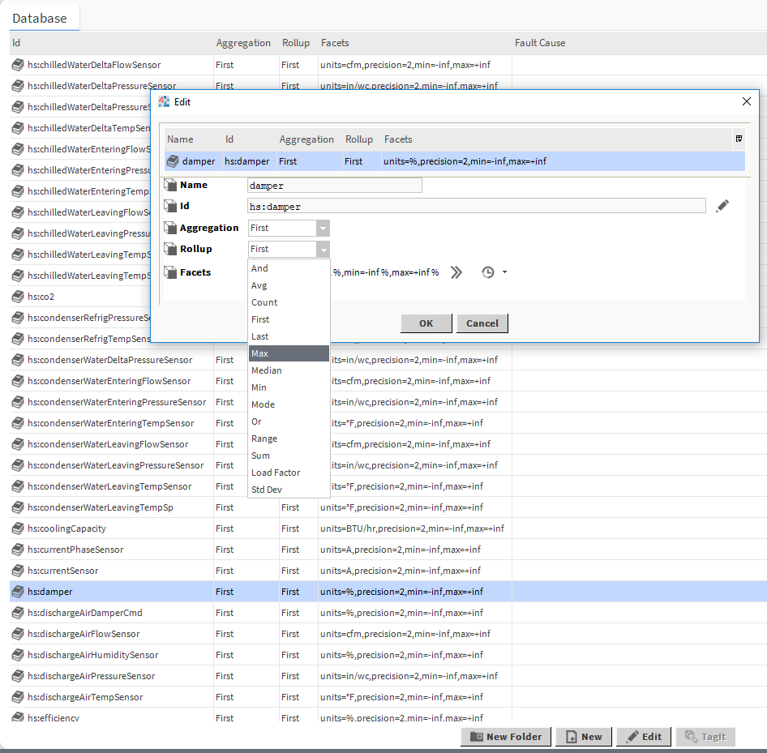
Definitions
Configures default values for facets, aggregation and rollup properties
Each tag requires a definition
Algorithm and graphic bindings define the tag and hierarchy location for searching
Combine retrieved data with properties defined for associated tag

Slide 21
Pollers
Workbench
Notes:
This is just a manager view that allows adding trigger components to automatically submit requests to the analytic service
Primarily used for analytic control points and alerts

Slide 22
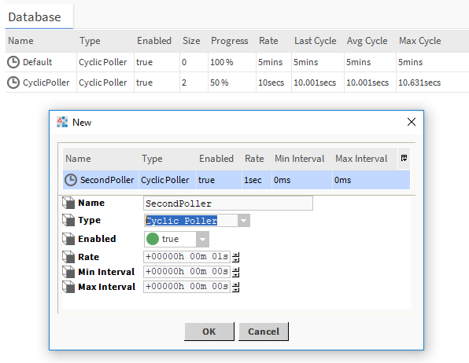
Pollers
How frequently the Niagara Analytics polls points for alert conditions
Cyclic poller execute an inquiry at even intervals
Trigger poller executes when you invoke an action

Slide 23
Algorithms
Workbench
Notes:
Blocks of wire sheet logic used by analytics to perform calculations on data in the station
Can be purely mathematical (calculate energy density) or like a fault detection algorithm to see when an abnormal condition exists.
Algorithms can be used in charts or tables to display information but can also be used in alerts to raise awareness
Show basic mathematical algorithm and a FDD algorithm

Slide 24
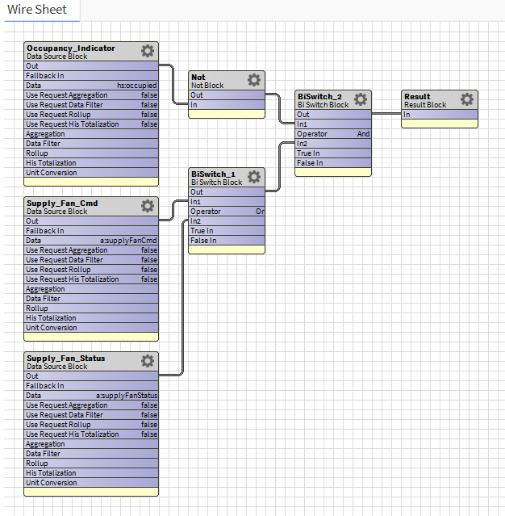
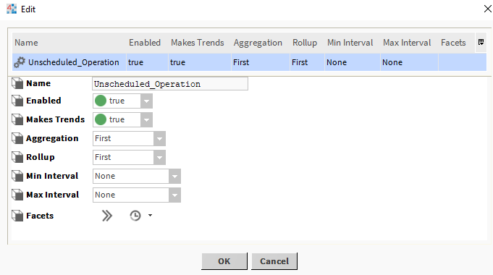
Algorithms
Objects that analyze data and produces results
Results can be visualized or reused in other calculations
Implemented with logic blocks and linked together using familiar wire sheets
Combine Historical and real-time data to produces both trends and single values

Slide 25
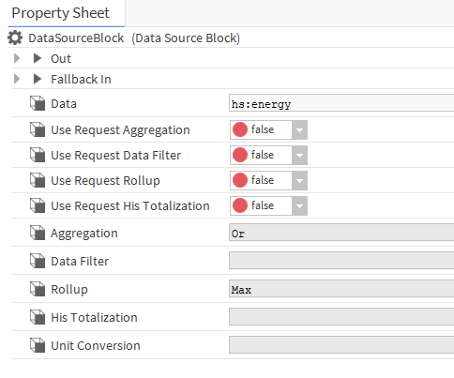
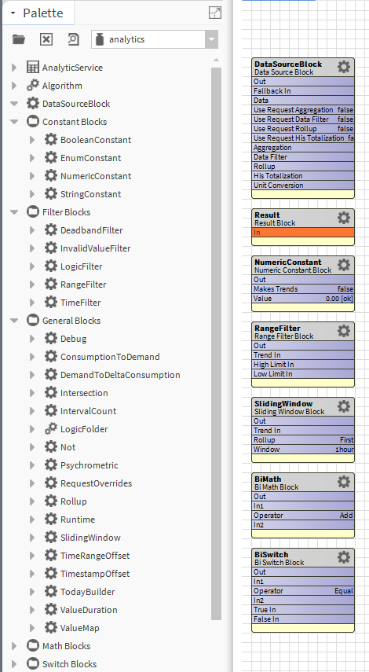
Logic Blocks
Consist of logic used to analyze data
Data Source – requests data from sources
Result – receives the output of algorithm calculation
Constant – supplies constant values
Filter – provide practical limits for inputs and outputs
General – miscellanous
Math – basic mathematical expressions
Switch – evaluates Boolean conditions for input/out

Slide 26
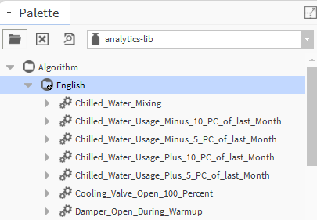
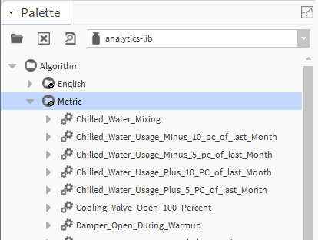
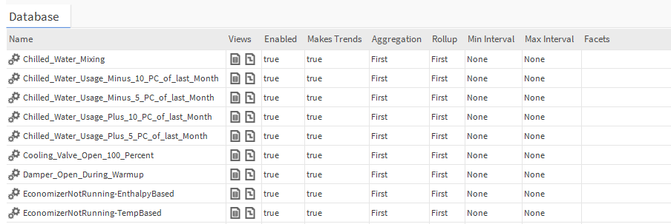
Algorithm Library
Pre-defined algorithms come included with software
Use as reference or modify to own specification
Drag algorithms into wire sheet and begin to configure your properties

Slide 27
Alerts
Workbench
Notes:
Manager view that allows defining which fault detection algorithms to use in the station
each alert configures which algorithm to use, which nodes in the station(config or hierarchy) to run the algorithm against

Slide 28
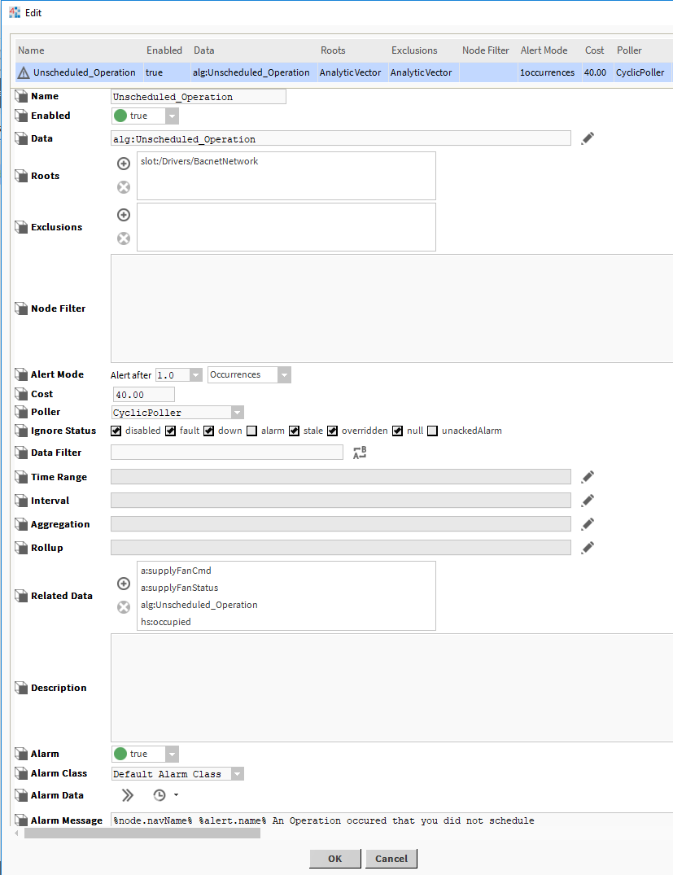
Alerts
Alerts run periodically based on pollers to collect real time and historical values
Uses Boolean values to determine conditions
Optional generation of Alarm Data
Filters data based on algorithm output or tags.
Alert Mode configures time or occurrence constraints
Notes:
In a way this is meant to replace “diagnostics” from AX analytics
Enables “smart alarming”

Slide 29
Control Points
Workbench
Notes:
Show control points in the wire sheet so people can see how the values and tags are applied
Analytic control point to show the analytic proxy extension, show a tag aggregating data from multiple sources
This is the key to doing close loop analytics
Other third party applications can extract the data from the Building automation system and generate their own data reports
Typically it will be up to the individual to decide what corrective action needs to be taken
Niagara Control points can be configured to run the analytic at some frequency which updates the point value and can be links to other control logic to automatically adjust the application and take corrective action
Duplicate control points and manipulate aggregation functions display min max avg sum..

Slide 30
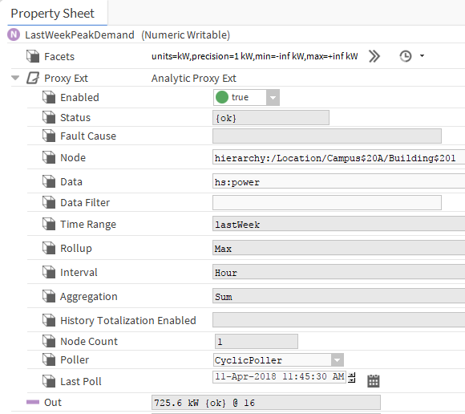
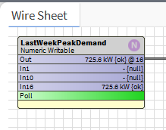
Control Points
You can use requests in control points to extract information from tags and algorithms
Value Request
Rollup Request
Trend Request
Analytic Alert Request

Slide 31
Bindings
Workbench
Notes:
Build a px view to demonstrate some analytic bindings
Use Bound labels with standard bindings to show control point values tagged with hs:energy
Use bound label with analytic value binding configure to show aggregate of all the control points. Emphasize that this is done using the binding and does not require the control point as done previously. (you only need the control points if you plan to do close loop analytics)
Use a bound table with an analytic table binding or an analytic bound table to request energy data for last month rolled up into

Slide 32
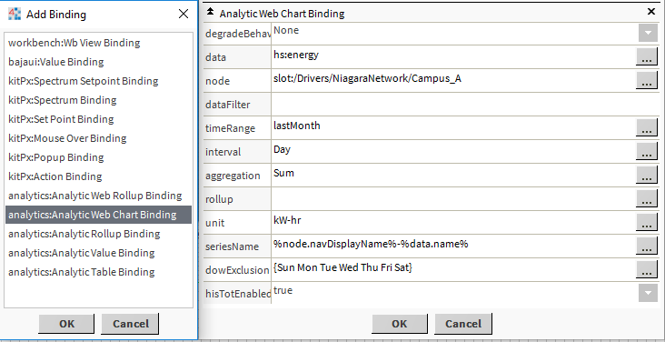
Graphic Bindings
Niagara Analytics Bindings
Work with standard Px Views
Web Chart Binding
Rollup Binding
Table Binding
Value Binding
Web Rollup Binding

Slide 33
Charts
Workbench
Notes:
Build a px with one of the analytic charts with multiple chart bindings
This is a fixed function report but allows user to change time range and chart configuration (available in 2.0)

Slide 34
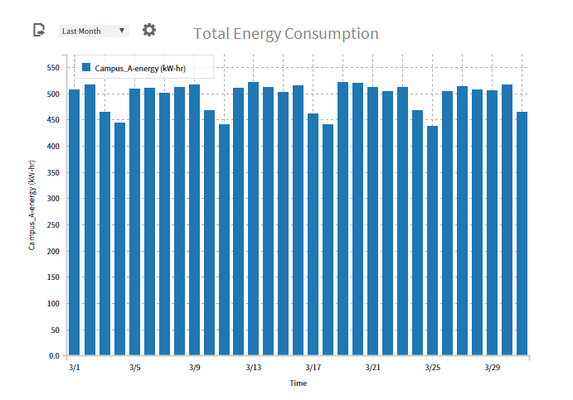
Aggregation Chart
Displays aggregated data from disparate systems
Data that has been combined for viewing
Chart supports a single binging
Used for combing a value for the root of a hierarchy

Slide 35
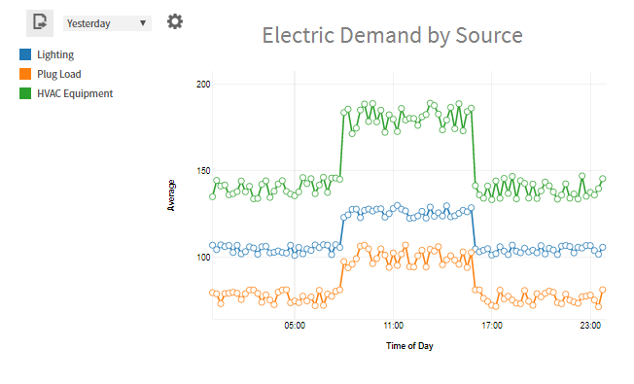
Average Profile Chart
Shows a pattern that represents the average of a data used over a specified time period
Provides flexibility when identifying high values at various times within a selected period of time
Supports multiple bindings
Plots time of day against the average of the data values

Slide 36
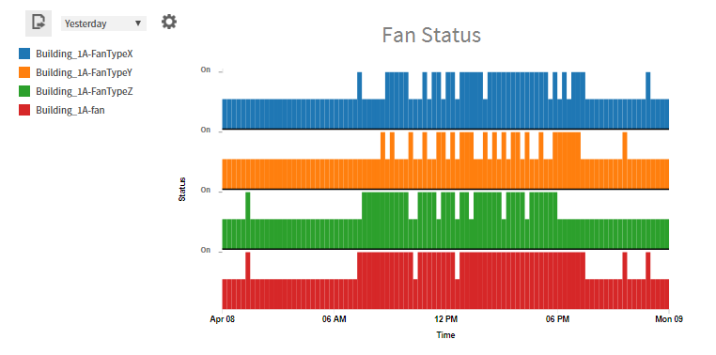
Equipment Operation Chart
Indicates when equipment is on or off
Supports multiple bindings for multiple pieces of equipment
Observing at what times the power to equipment went on or off, the chart can expose a trend
Compare time periods with temperature spikes
Useful in Dashboard

Slide 37
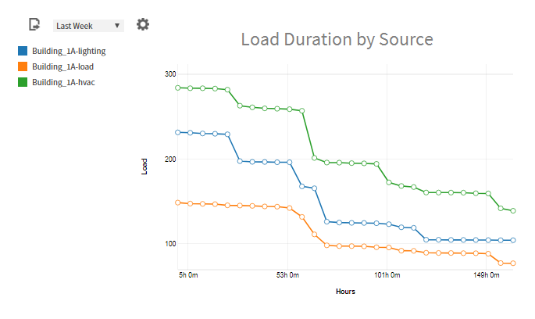
Load Duration Chart
Summarizes how long a value was above a certain level
Helps to observe the duration of peak demand levels
Helps identify correct demand limiting strategies

Slide 38
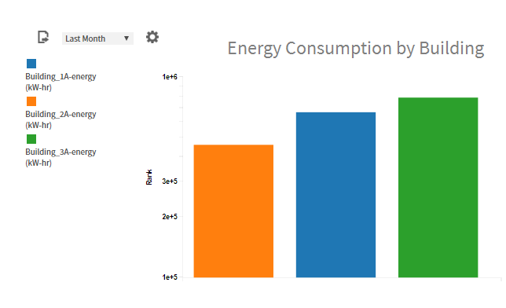
Ranking Chart
Compares values from selected nodes using vertical bars
Supports multiple bindings
Use to quickly identify values that or high or low
Separate or aggregate components over different time values to identify root causes and effects

Slide 39
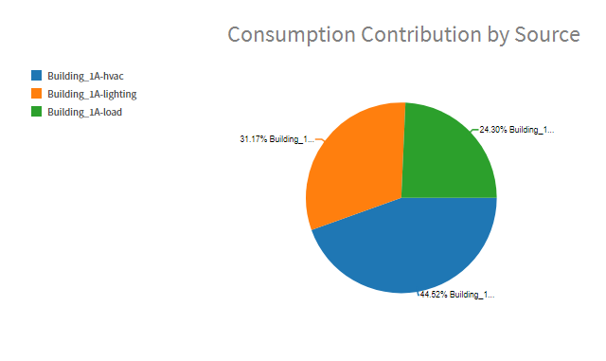
Relative Contribution Chart
Pie chart plots the contributions from individual pieces of equipment (or any data model) to the total value of a group
Compare contributions of your data to total energy consumption of a campus.
Equipment vs Lighting, Location by Location, Manufacturer Brands, etc.

Slide 40
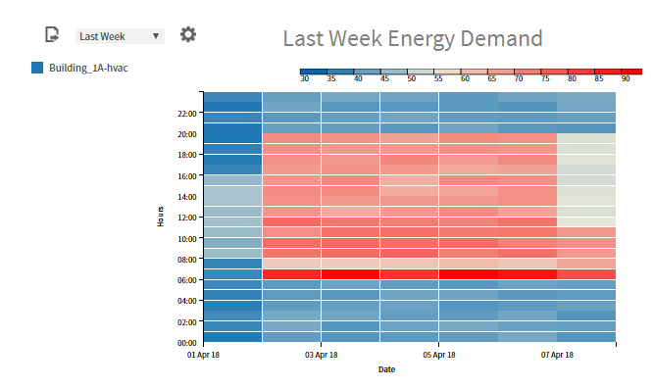
Spectrum Chart
Provides insight on “reasonableness” of data collected
Quick glance observes patterns that can confirm an expected condition
Draws immediate attention to situation that requires analysis

Slide 41
Reports
Web Browser
Notes:
Show the report builder under the analytics services (new to 2.1)
Allows users to build ad hoc reports and to change existing reports
I would like to show each of these reports already configured with points.

Slide 42
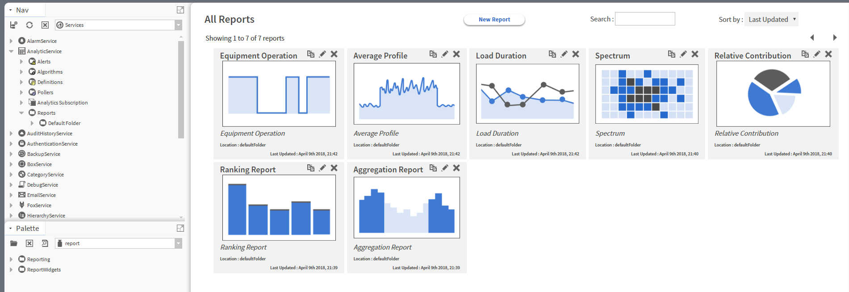
Reports

Slide 43
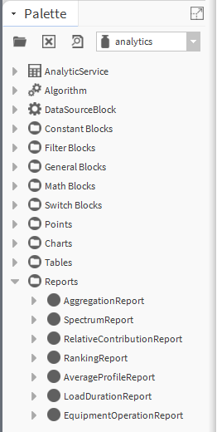
Reports
A document that contains information organized as a narrative, graphic, or table
Can be prepared on an ad hoc, periodic, recurring, regular, or as required basis
Reports identify trends

Slide 44
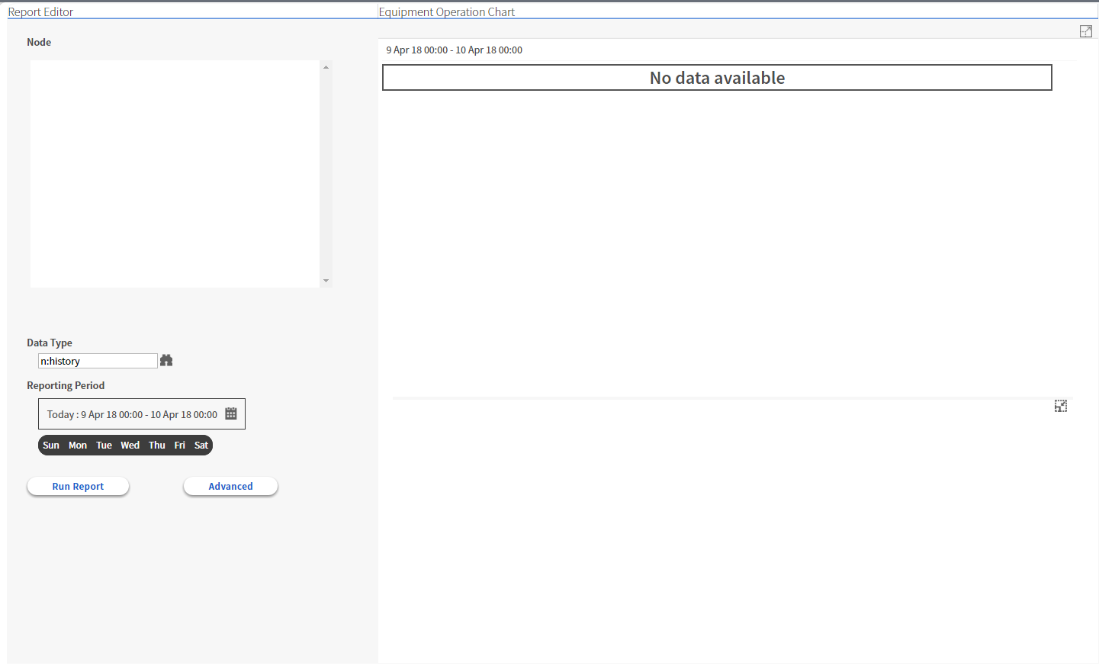
Report Editor
All reports share the same report editor
Node Pane
Chart Area
Table Area
Settings
Notes:
Drag nodes for data visualization scope
Populates configured data in a chart
“” table
Settings determine things like period what data tag to search for
Advanced configures additional properties

Slide 45
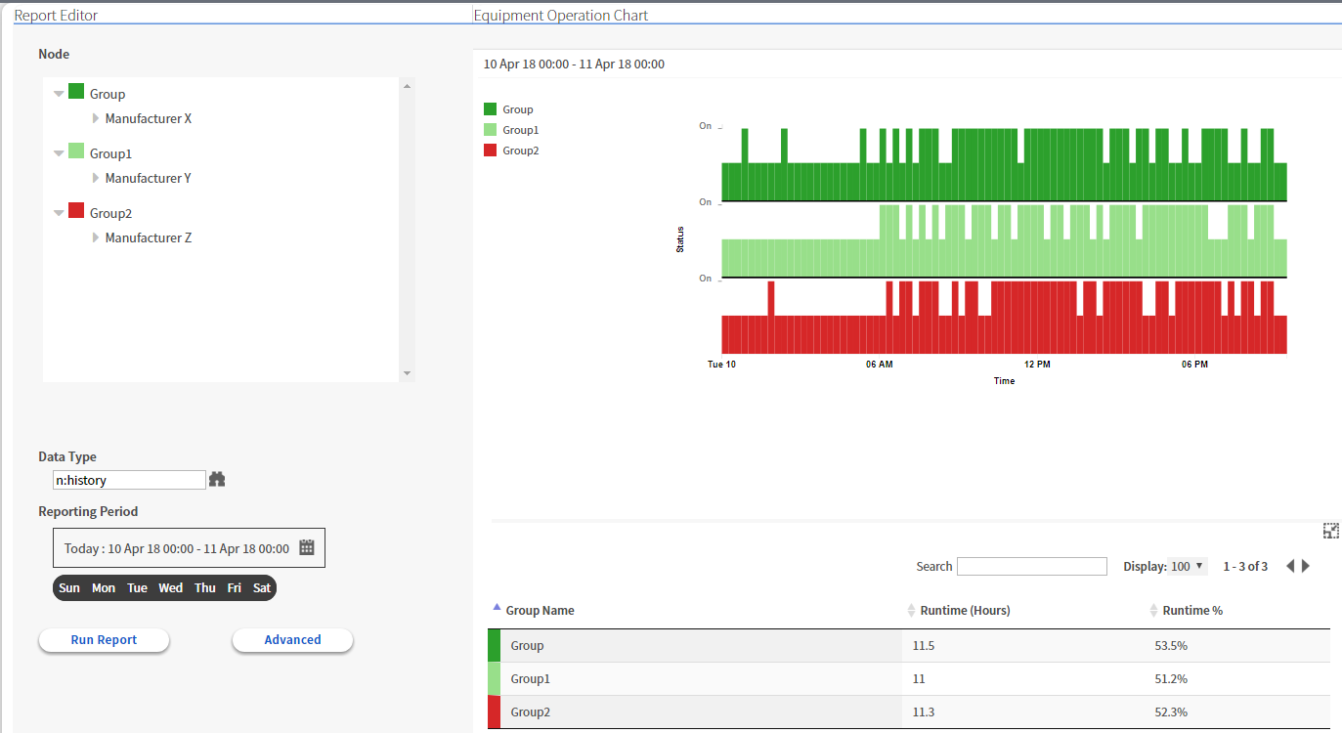
Equipment Operation Report

Slide 46
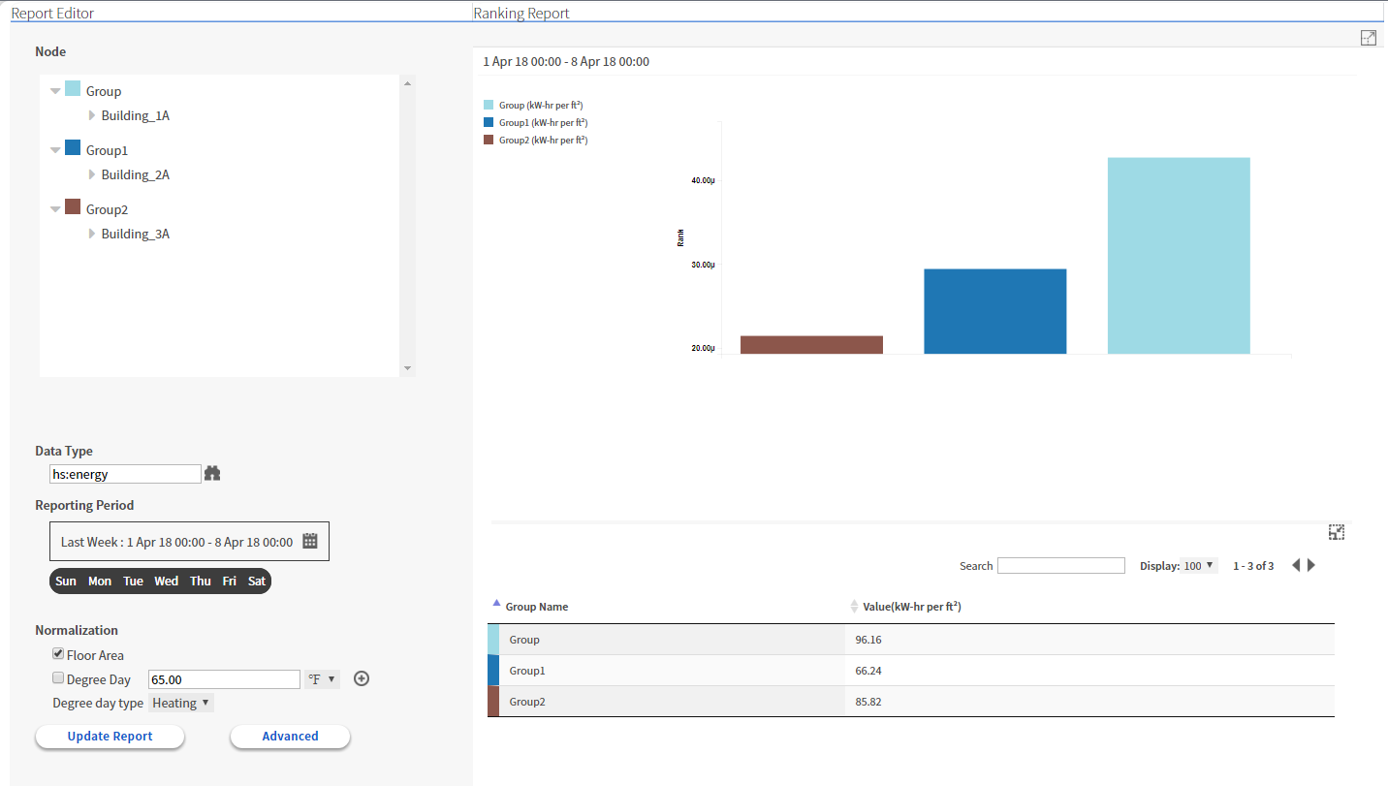
Ranking Report

Slide 47
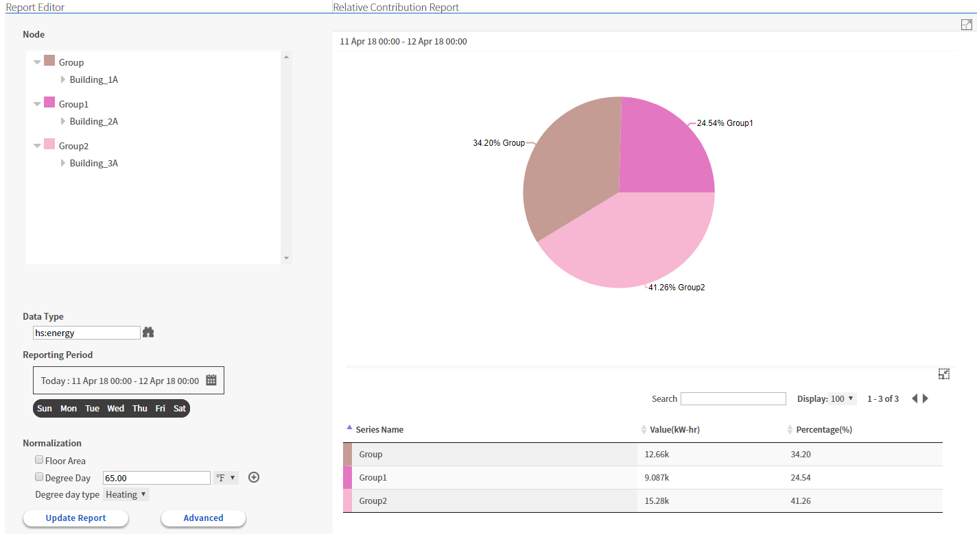
Relative Contribution Report

Slide 48
Aggregation Analysis Report

Slide 49
Load Duration Report

Slide 50
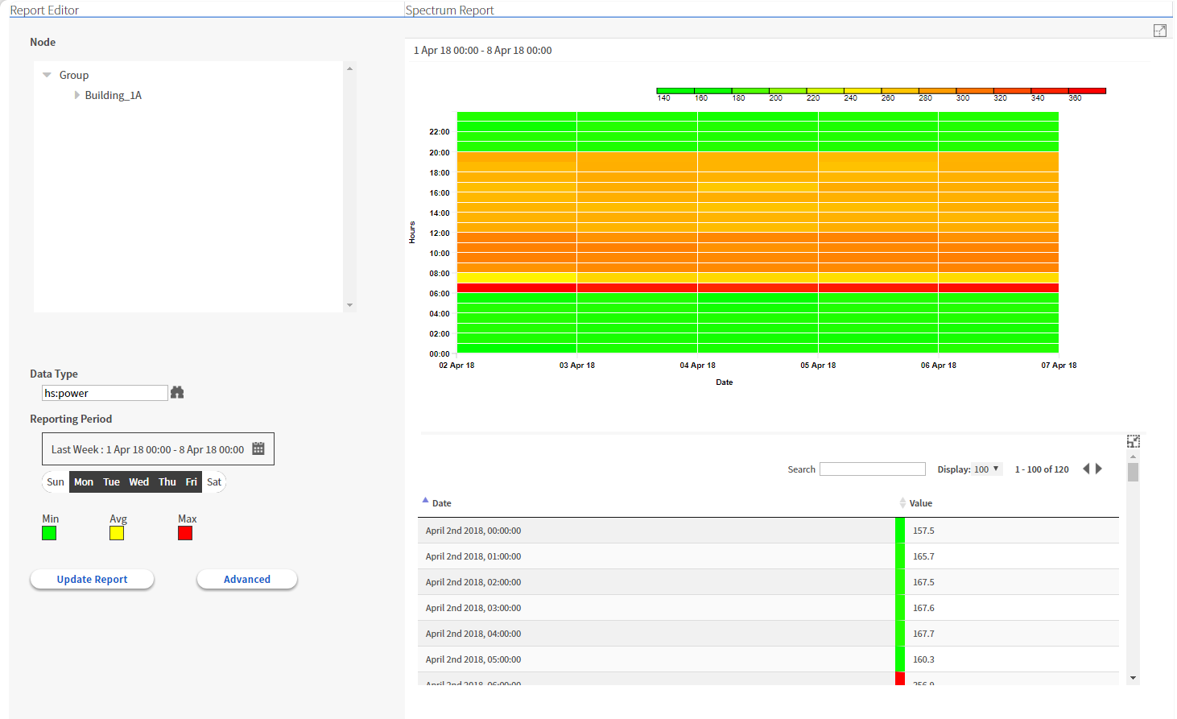
Spectrum Summary Report

Slide 51
Summary

Slide 52
Summary
Tag – A piece of semantic information associated with and entity, for the purposes of filtering or grouping, “metadata”
Data Definition – Defines the type of information a request is looking for, related to tags
Data Model – A hierarchical structure that organizes points based on usage or reporting
Trend – The result of analyzing historical data collected by the system.
Bindings – display individual values, rollup values from single source, and aggregate values from disparate sources

Slide 53
Summary
Request – query for input data that seeks either a point’s current or most recent historical value
Aggregation – The process of combining multiple pieces of the same type of data into a single value.
Rollup – The process of combining historical data for a single data source into one value
Analytics – the discovery and presentation of meaning full patterns in data

Slide 54
Summary
Niagara Analytics is a logical extension of the Niagara Core Framework
It is an application that utilizes tagging and hierarchies to help end users make informed decisions about their data
It allows system integrators to reduce engineering time
Enhances displays with customizable dashboards based on algorithms calculations and combining real time and trend data.
Adding Alarms to Alerts allow you to reduce nuisance alarms

Slide 55
Niagara Analytics
Kyle Sardinia

